Slide 1
Rapid Optimization Model Development with Python and Pandas
Rob Randall, PhD, Senior Optimization Specialist
Irv Lustig, PhD, Optimization Principal

Slide 2
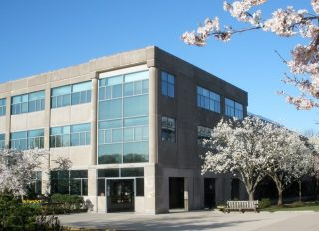

About Princeton Consultants (www.princeton.com)
Information Technology & Management Consulting
Advanced Analytics
Strategy
Application Development
Process Improvement
Optimization into Production
Princeton New Jersey
New York City
Stability: Founded in 1981; over 1800 successful completed projects for many industry leaders and fast-growing innovators.
Representative Clients: 2020 US Census, US Tennis Association, NBCUniversal, Wells Fargo, NetJets, The Wall Street Journal, Schneider, Pepsi, Birchbox, NYISO.
Analytics-focused Professional Staff: 65 full-time consultants, 2/3rds with graduate STEM degrees; plus network of top independent consultants and university professors. 50+ experienced data scientists/developers.
Experience: Senior Staff (top 28 consultants) average 15+ years experience; Firm Leadership (6 Directors) average 20+ years experience.
Notes:
Princeton Consultants is an IT and management consulting firm that specializes in building production optimization systems.
Princeton was founded in 1981 and has successfully completed over 1800 projects and is a Gurobi optimization business partner.
With a full-time analytics focused professional staff with the senior staff averaging over 15 years of experience at delivering successful projects over many verticals, Princeton can deliver results for your company.

Slide 3

“Life-Altering” Improvements
“The increase in speed and flexibility from the new model impacts every piece of our business across multiple teams. Now we can strategically invest that time in everything from building more personal customer experiences to optimizing our production process. With this new model, Birchbox has truly entered a new operating universe.”
David Bendes
Vice President of Global Business Technology at Birchbox

Slide 4
Introduction
Princeton Consultants has developed an approach that we believe improve the likelihood of success in optimization projects
The main tools that we use in the development are python with the pandas library
We often use this in concert with IBM ILOG CPLEX python interface (docplex) or Gurobi’s python interface (gurobipy)
These techniques have been applied to multiple clients and verticals successfully and are presented to you here

Slide 5
Understand the Data
Understanding the data required is an ABSOLUTE NECESSITY for an optimization project to be successful
In this step we work with our clients to understand:
What data is available
The semantic meaning of that data
How they organize that data
How different pieces of data are related to each other
This is the MOST IMPORTANT step in an optimization project, because without a deep understanding of the data available for optimization, we cannot build a good model

Slide 6
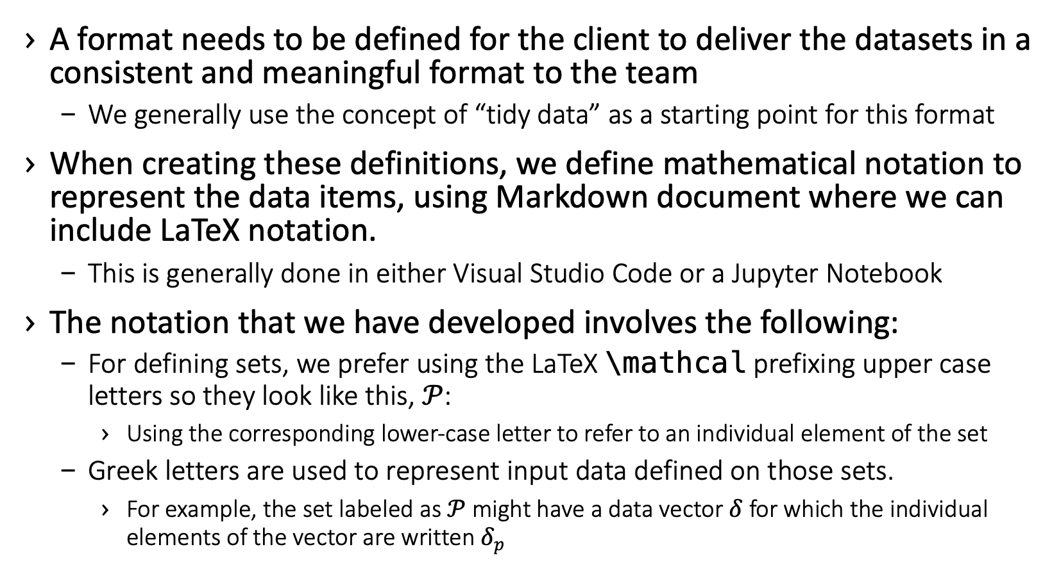
Define and Document Datasets
A format needs to be defined for the client to deliver the datasets in a consistent and meaningful format to the team
We generally use the concept of “tidy data” as a starting point for this format
When creating these definitions, we define mathematical notation to represent the data items, using Markdown document where we can include LaTeX notation.
This is generally done in either Visual Studio Code or a Jupyter Notebook
The notation that we have developed involves the following:
For defining sets, we prefer using the LaTeX \mathcal prefixing upper case letters so they look like this, $𝒫$:
Using the corresponding lower-case letter to refer to an individual element of the set
Greek letters are used to represent input data defined on those sets.
For example, the set labeled as $𝒫$ might have a data vector $δ$for which the individual elements of the vector are written $δ_{p}$

Slide 7
Collect and Transform Data
We start by collecting the data from the client in their format, which we label the “raw data format”.
This likely comes from a production system that stores data in a specific way and that may not be what is needed for the model.
We write python and pandas code to transform this into a format that can be used by the model, which we call the “model data format”
This may include something like a piece of data that comes in as a calendar time, but the model needs to transform that into something it can operate on, which we may agree are discrete 5 minute periods, so we write code that transforms the calendar times into these discrete periods
As we work on this code, sometimes we must update our documentation of the tidy data format that we are expecting

Slide 8
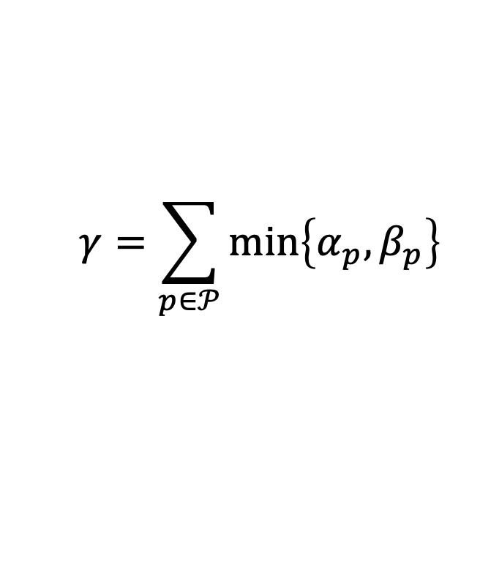
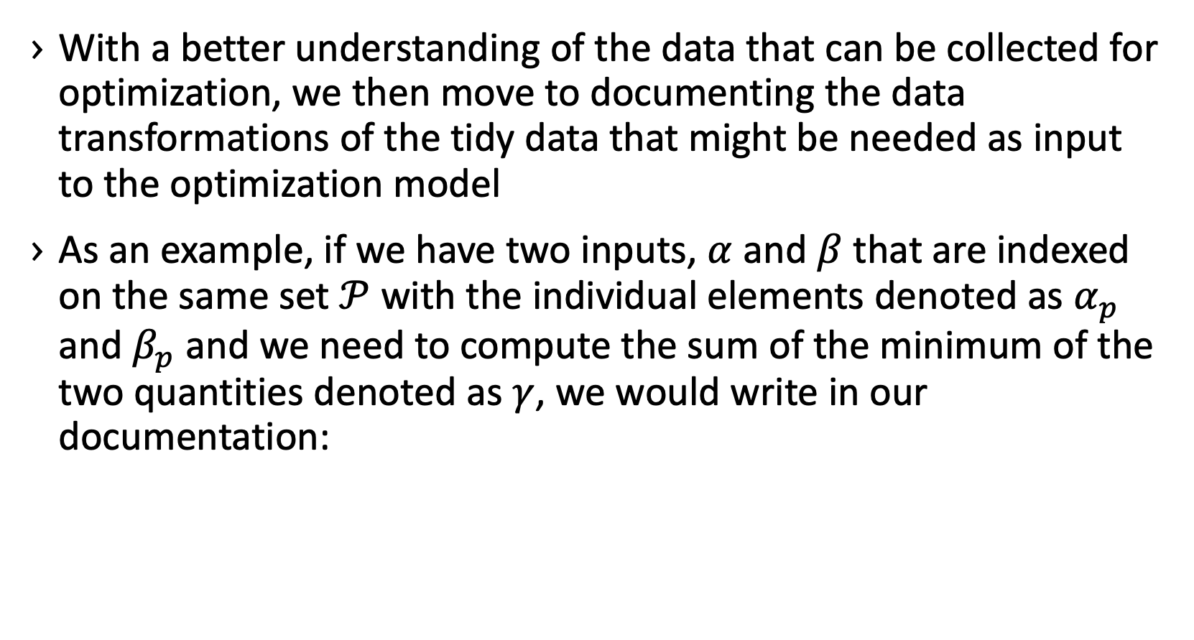
Document Data Transformations
With a better understanding of the data that can be collected for optimization, we then move to documenting the data transformations of the tidy data that might be needed as input to the optimization model
As an example, if we have two inputs, $α$ and $β$ that are indexed on the same set $𝒫$ with the individual elements denoted as $α_{p}$ and $β_{p}$ and we need to compute the sum of the minimum of the two quantities denoted as $γ$, we would write in our documentation:
$$γ=\sum_{p∈𝒫}{min⁡\left\{α_{p},β_{p}\right\}}$$

Slide 9
Create Model Documentation
Now that the data inputs and transformations are documented, we can write a document that describes the optimization model that we will build. This includes:
Decision variables
Our convention is to use a single lower-case English letter for a decision variable
The sets that describe these variables are listed using subscripts
Objective function
Constraints
In addition to writing these out mathematically, each are also described in English to ensure that we know what each is trying to accomplish
This provides a means to audit them later and to help others understand what the math should be doing

Slide 10
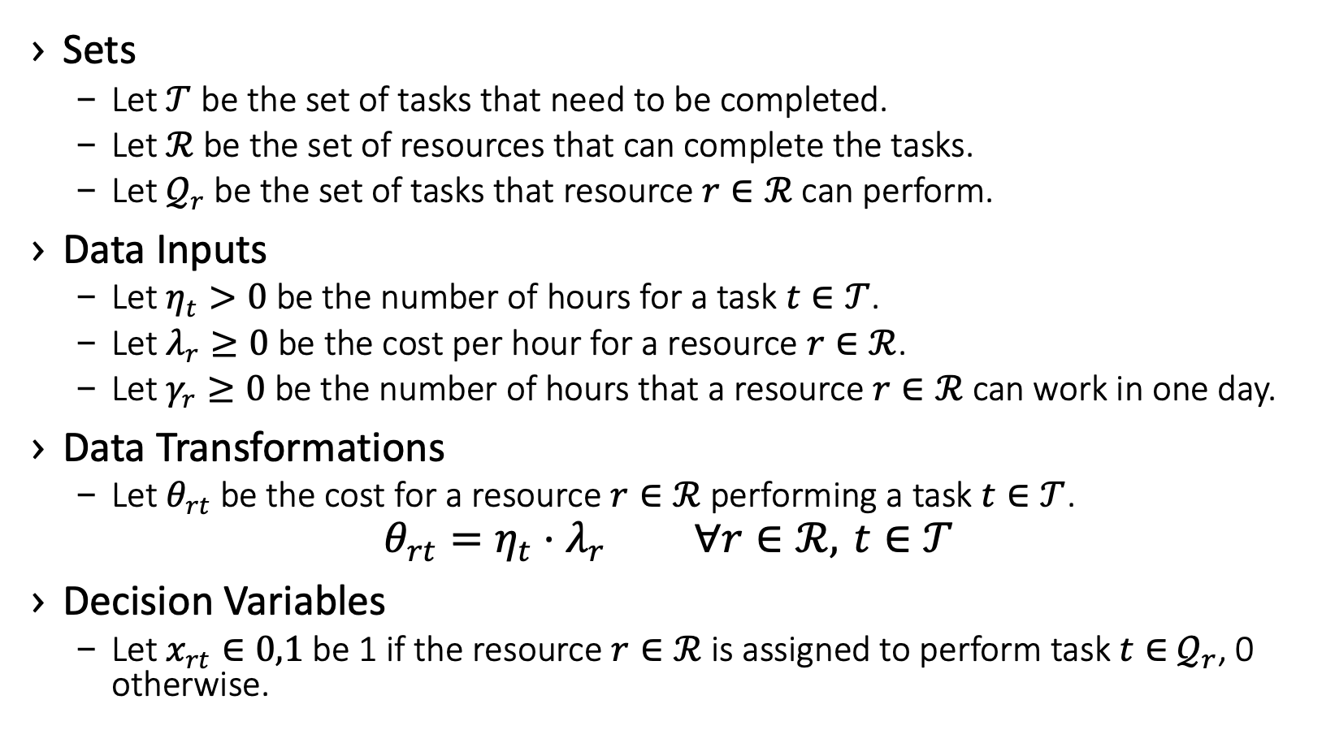
Simple Documentation Example
Sets
Let $𝒯$ be the set of tasks that need to be completed.
Let $ℛ$ be the set of resources that can complete the tasks.
Let $𝒬_{r}$ be the set of tasks that resource $r∈ℛ$ can perform.
Data Inputs
Let $η_{t}>0$ be the number of hours for a task $t∈𝒯$.
Let $λ_{r}≥0$ be the cost per hour for a resource $r∈ℛ$.
Let $γ_{r}≥0$ be the number of hours that a resource $r∈ℛ$ can work in one day.
Data Transformations
Let $θ_{rt}$ be the cost for a resource $r∈ℛ$ performing a task $t∈𝒯$.
$$θ_{rt}=η_{t}⋅λ_{r} ∀r∈ℛ, t∈𝒯$$
Decision Variables
Let $x_{rt}∈0,1$ be 1 if the resource $r∈ℛ$ is assigned to perform task $t∈$ $𝒬_{r}$, 0 otherwise.

Slide 11
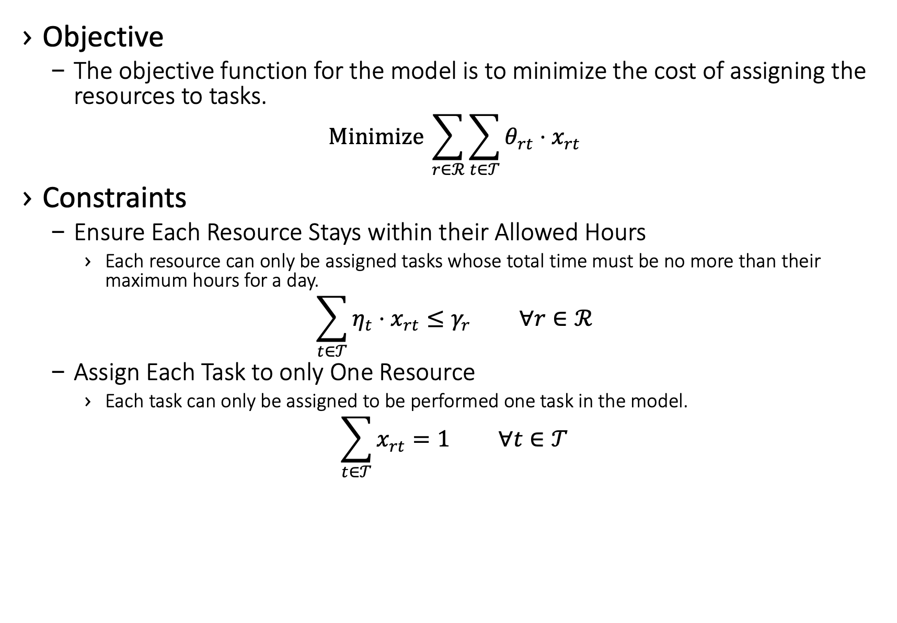
Simple Documentation Example
Objective
The objective function for the model is to minimize the cost of assigning the resources to tasks.
$$Minimize \sum_{r∈ℛ}^{​}{\sum_{t∈𝒯}^{​}{θ_{rt}}}⋅x_{rt}$$
Constraints
Ensure Each Resource Stays within their Allowed Hours
Each resource can only be assigned tasks whose total time must be no more than their maximum hours for a day.
$$\sum_{t∈𝒯}^{​}{η_{t}}⋅x_{rt}≤γ_{r} ∀r∈ℛ$$
Assign Each Task to only One Resource
Each task can only be assigned to be performed one task in the model.
$$\sum_{t∈𝒯}^{​}{x_{rt}}=1 ∀t∈𝒯$$

Slide 12
Build Model
Now that the data inputs and transformations are documented and we’ve created a formulation that we believe solves the problem for the business, we FINALLY start writing code for the model.
For complicated models, we often start with a prototype in a Jupyter Notebook.
This allows for rapid testing to ensure that the model is built correctly
Then we can take the prototype and convert it into a class object that can be integrated into whatever system we’re building
Often, we end up turning the model into a RESTful service endpoint. When doing so, we believe in separating the model code from the service
This provides for the model to be created and tested without the service and allows for more parallel development

Slide 13

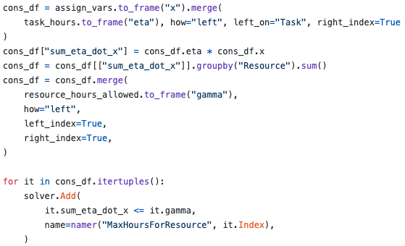

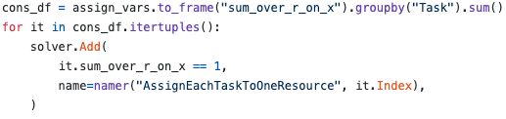
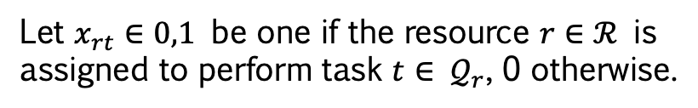
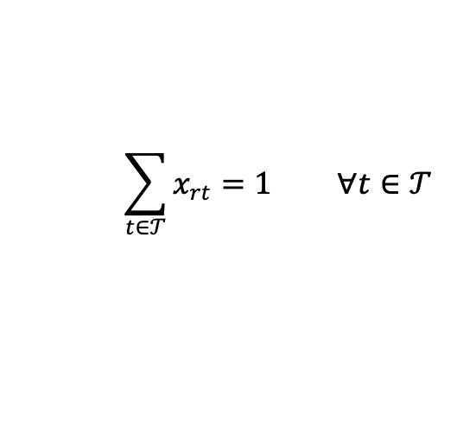
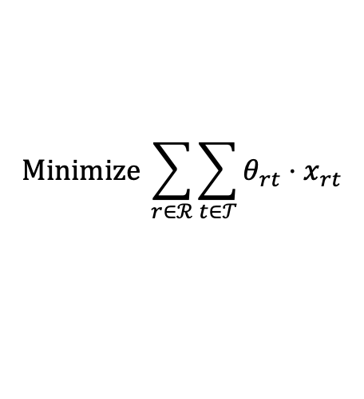
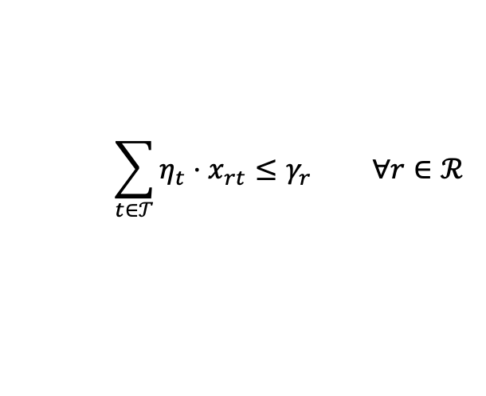
Build Model – Example
When building the model, we generally create separate functions to build the variables, build each constraint type, and build the objective
Let’s look at a few examples of how we use the power of pandas to build the model
Let $x_{rt}∈0,1$ be one if the resource $r∈ℛ$ is assigned to perform task $t∈$ $𝒬_{r}$, 0 otherwise.
$$\sum_{t∈𝒯}^{​}{η_{t}}⋅x_{rt}≤γ_{r} ∀r∈ℛ$$
$$Minimize \sum_{r∈ℛ}^{​}{\sum_{t∈𝒯}^{​}{θ_{rt}}}⋅x_{rt}$$
$$\sum_{t∈𝒯}^{​}{x_{rt}}=1 ∀t∈𝒯$$

Slide 14
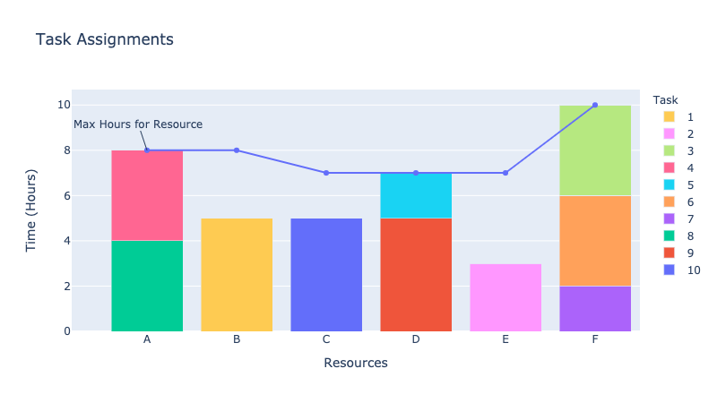
Review Results
For reviewing results it helps to have a visual representation to review with clients
One tool that we like is plotly
The plot here shows the assignment of the tasks to resources and how much time each resource is working, with another line for the max time for each resource

Slide 15
Development Tools
Here are some of the tools that we use, and recommend, for developing models
Anaconda – Package manager that allows for easy environment setup
Visual Studio Code – Rich IDE with git (and svn) integration, along with many other extensions
We use pylance as a tool inside Visual Studio Code to evaluate our python code for potential issues
mypy – Type checks code for potential issues
pytest – This is a testing harness in python that is straightforward to set up and create tests
typing – Built-in Python library for specifying variable types and the return types for functions
Docstrings – Tool in python that allows for functions to describe their inputs and outputs as well as the intent of the function
Markdown – Used to create data and model documentation
Pandoc – Is used to generate PDF documents from the model documentation markdown
Jupyter – Used to analyze data and create proofs of concept
Solver APIs
gurobipy – Gurobi library for python development
docplex – IBM ILOG CPLEX and CPO library for python model development
ortools – Google OR-Tools library for python model development

Slide 16
Review
Understand the data
Define and document datasets format
Collect data from the client
Document all data transformations needed
Document the model that you intend to build
Write the optimization code
Review the results with the clients and iterate

Slide 17
Resources
Princeton blog post on rapid model development: https://www.princetonoptimization.com/blog/blog/princeton%E2%80%99s-rapid-optimization-model-development-approach-python-and-pandas
Demo code shown in this presentation: https://github.com/rrandall1471/2020-INFORMS-Demo

